Slide 1

Collecting Textiles:
Make It Work for Your Community

Slide 2
Your Name
Your Company Name
SMART Member
Date

Slide 3
Today’s Definition of
Acceptable Textiles to be Recycled
Any clothing, household textile or commercial linen textile as long as it is CLEAN, DRY and has NO ODOR can be reused and recycled.

Slide 4
Acceptable Items to Reuse/Recycle Include:
Bedding:
(comforters, sheets,
pillow cases, blankets)
Belts
Boots
Bras
Coats
Curtains/Draperies
Dresses
Flip flops
Halloween costumes
Hats
Jackets
Jeans
Jerseys (sports)
Napkins (cloth)
Pajamas
Pants
Pet beds & clothing
Pillows
Purses
Scarves
Shirts
Shoes (single or in pairs)
Shorts
Skirts
Slippers
Socks (single or in pairs)
Stuffed animals
Suits
Sweaters
Sweatpants
Sweatshirts
Table linens
Ties
Towels
T-shirts
Undergarments

Slide 5
Use of the Term “Recycling” Within the Textiles Industries
The industry tends to use the words recycled and reused interchangeably.
The clothing that is sold in charity thrift store and sold to developing nations would be considered “reuse”
The textiles that are turned into wiping rags and the textiles that are ground up into fiber would be considered recycled.

Slide 6
Why Recycle Textiles?
16.22 million tons of textiles were discarded in 2014 or 84%
Only 2.62 million tons were reused or recycled or 16%
6.3% of landfill waste is comprised of textiles; equals 81 pounds per person thrown away annually
Source: EPA report on Advancing Sustainable Materials Management 2014 Fact Sheet and Tables and Figures (Nov. 2016)

Slide 7
Why Recycle Textiles?
Carbon footprint reduction
Clean air preservation
Reduce energy consumption
Water conservation
Woodland conservation

Slide 8
Beneficial Impact of Recycling Textiles
The EPA estimates the current level of recycling on reducing greenhouse gasses
Yard Waste = removes 651,000 cars
Glass = removes 175,000 cars
Plastic = removes 670,000 cars
Aluminum = removes 1.3 million cars
Textiles = removes 1.3 million cars
Source:EPA report on Advancing Sustainable Materials Management 2014 Fact Sheet
(Nov. 2016) Table 5. Page 15.

Slide 9
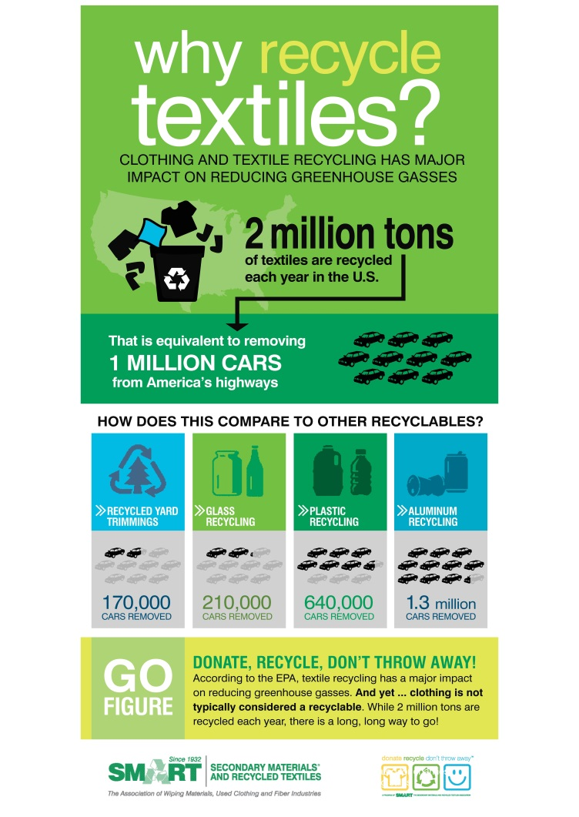

Slide 10
Where Does Recycled Clothing Go?
45% used for secondhand apparel
30% become wiping and polishing cloths
20% reprocessed into fibers
5% is unusable

Slide 11
Can Textiles Be Recycled?
Yes!
Oldest form of recycling
Annually…
  Average person discards 81 lbs of clothing
  SMART/charities divert 4 billion lbs. of waste
  SMART is reducing the world’s carbon footprint
  Only 16% of textiles currently being diverted
Remember – Donate, Recycle, Don’t Throw Away!

Slide 12
How Are Textiles Reuse & Recycling Industries Different Today?
The industry (process) has not changed in hundreds of years. What has changed is the industry is becoming more transparent and now being recognized by both Charities and regulators as having a positive environmental impact as a recyclable and an economic sector.

Slide 13
Textile Recycling Drives Economy
Revenue stream for recycling agencies
Creates jobs
Funds charitable initiatives
Promotes small business
Encourages recycled product development
Provides affordable clothing opportunity

Slide 14
Can Businesses Recycle Textiles?
Yes!
Healthcare facilities
Hotels and hospitality facilities
Textile & paper mills/manufacturers
Cut and sew plants
Textile dye facilities
Retail stores
Government agencies
Recycling textiles is EVERYONE’S business!

Slide 15
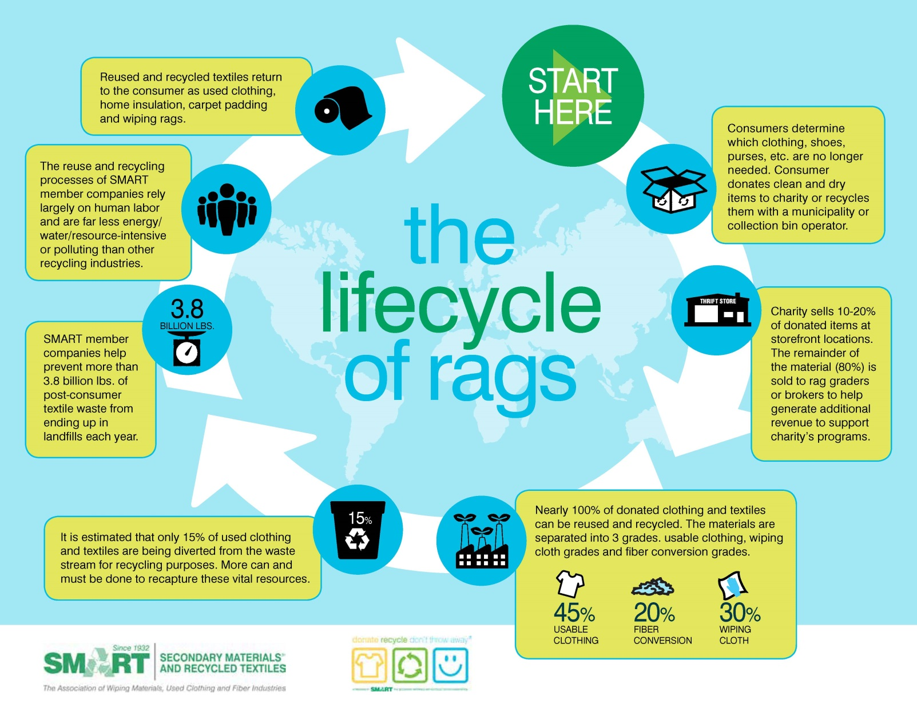

Slide 16
SMART Background
SMART – what does it stand for?
Nonprofit trade association, established in 1932
For Profit Used clothing, wiping material, fiber companies
Nearly 150 companies worldwide
Committed to “green” way of life

Slide 17
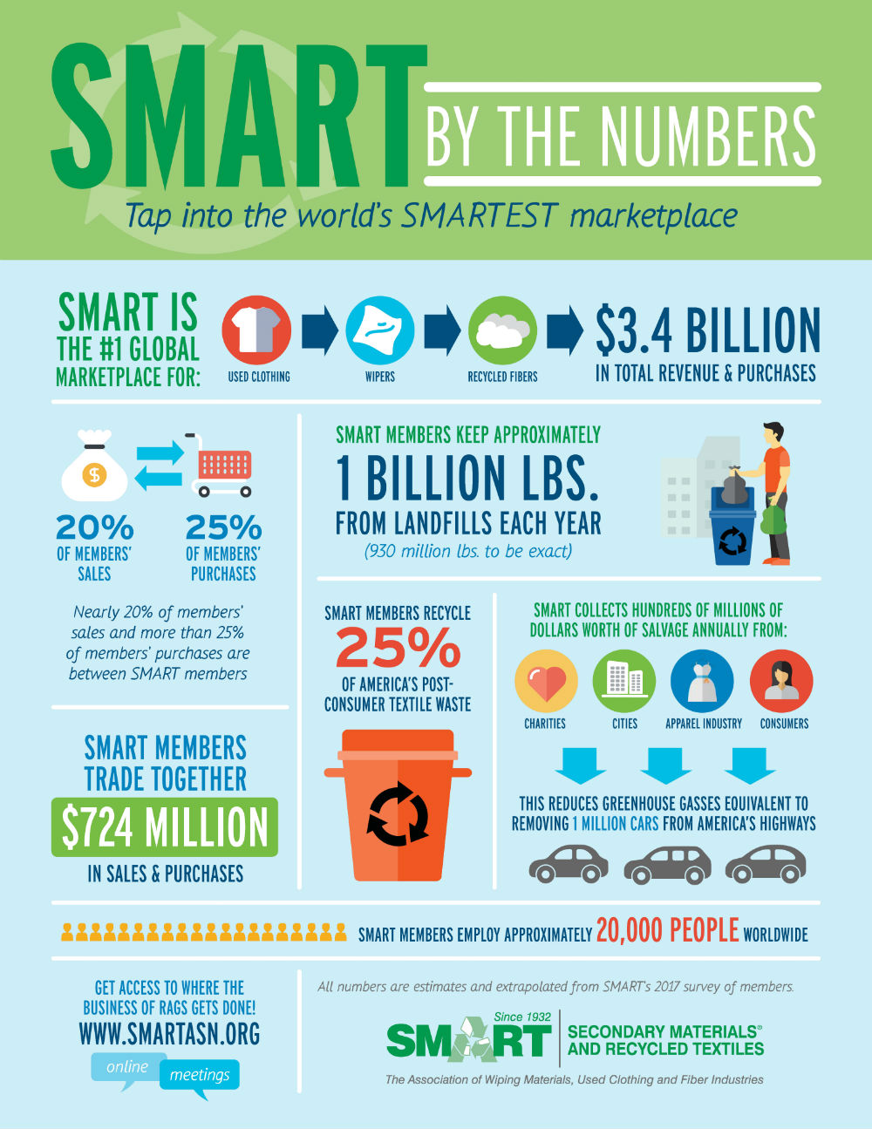

Slide 18
SMART’s Vision
SMART is the leading industry voice promoting high standards and best practices for reuse and recycling of textiles and related secondary materials. Our members reduce solid waste, by collecting, reclaiming, and “close the loop” by processing, reusing, converting, and distributing these recyclables.

Slide 19
What do SMART Companies Do?
Pre-consumer market
  Acquire byproduct from textile/fiber companies
  Repurpose material for consumer products
  Wiping cloths, insulation, home furnishings…
Post-consumer market
  Acquire textiles from charity & commercial linens
  Once graded, clothing is recycled for various markets
  Used clothing, Wiping cloths, insulation…

Slide 20
How does SMART Recycle?
Reduce solid waste through life extension
Reuse gently worn clothing
Repurpose/recycle into wiping cloths
Recycle and convert to fiber

Slide 21
SMART’s Goals
Increase awareness of need to recycle textiles
Increase supply of textiles in marketplace
Decrease the amount of clothing and textiles in landfills
Offer help and expertise to government in developing programs to promote textile recycling and help find recycling company partners
Reduce cost to municipalities by reducing tipping fees associated with textile waste disposal
Capture remaining 85% of textiles that are not being recycled – Donate, Recycle, Don’t Throw Away.
Educate students about textile recycling through Recycling Rangers program for grades K-5

Slide 22
Recent SMART Initiatives - Education
Lesson Plans for Elementary Students
- Grade Appropriate for students Grades K-5
- Available free from SMART website under Educators & Kids
- SMART’s Goal was to reach 1 million students by 2015. This goal was achieved in March 2015 in conjunction with 2014-15 campaign.

Slide 23
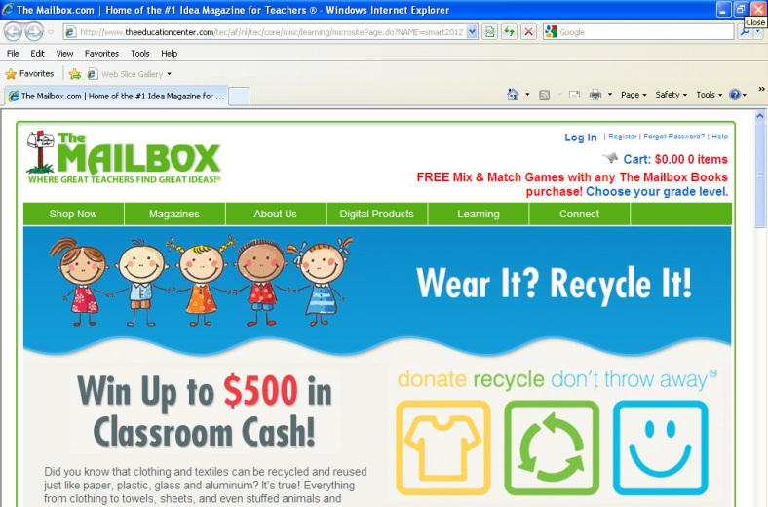

Slide 24
Recent SMART Initiatives - Communication
Television PSA
- Community Recycling of Clothing and Textiles
- 60: second spot
Radio PSAs
- 4 versions, 30:seconds each
- Scripts include: Back-to-School;
Earth Day; Spring Cleaning; End-of-the-Semester
Info graphics to help tell story about textile recycling and benefits to environment
SMART Member Locator

Slide 25
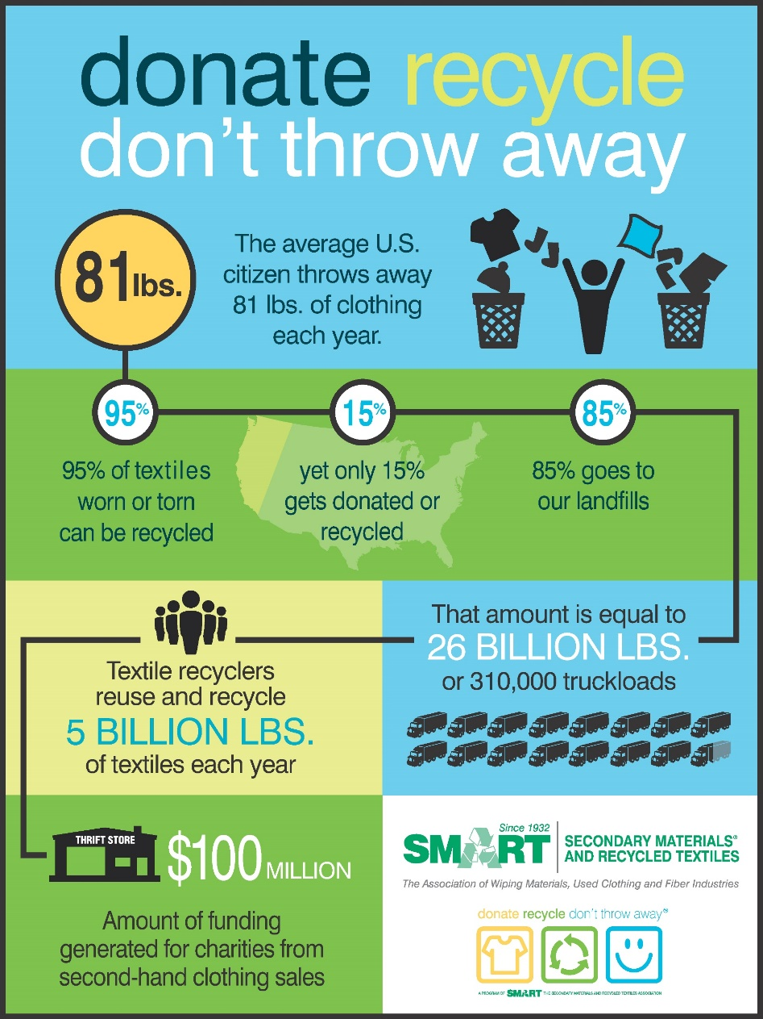

Slide 26
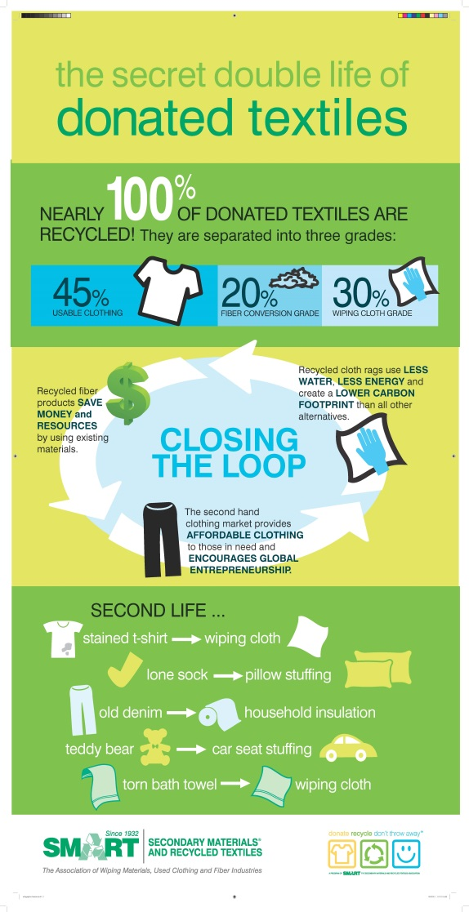

Slide 27
SMART Member Locator
Listing of SMART Members on www.smartasn.org
Searchable by
Product Category, Company Name, State & Country
Available to Public

Slide 28
Recent SMART Initiatives - Legislative
Clothing Collection Bins in the Community
- Clothing Collection Bin Operator Code of Conduct
- Draft Ordinance Language
- Bin Position Paper
- Development of Bin Committee of SMART
members to work on proactive efforts in cities
and towns
- Municipality Outreach Document
- Ongoing outreach to communities about benefits of textile recycling and need for reasonable regulations

Slide 29
How Can You Help?
Provide convenient collection points
Promote textile recycling days
- Earth Day (April 22)
  - America Recycles Day (November 15)
  - End-of-the-Semester (partner with local colleges)
Include textile recycling in all public relations and
promotion efforts supporting recycling programs
Help educate the recycling public about textile recycling
Encourage public agencies to use wiping products made from recycled textiles

Slide 30
Recent SMART Initiatives - ReClothe NY
Partnership with NYSAR3 and CTR for first ever statewide textile recycling campaign
- ReClothe NY launched in conjunction with America Recycles Day 2014
Included PR toolkit for local recycling coordinators to use to conduct outreach to local media about program
Developed Operational Manual for Communities to use to help them launch events around campaign
Award Winning Program – 2015 EPA Environmental Champion Award – Region II

Slide 31

Additional Questions?
Contact SMART
Jackie King, Executive Director
443-640-1050 x105
jackie@kingmgmt.org
www.SMARTasn.org
Thank you!

